Slide 1
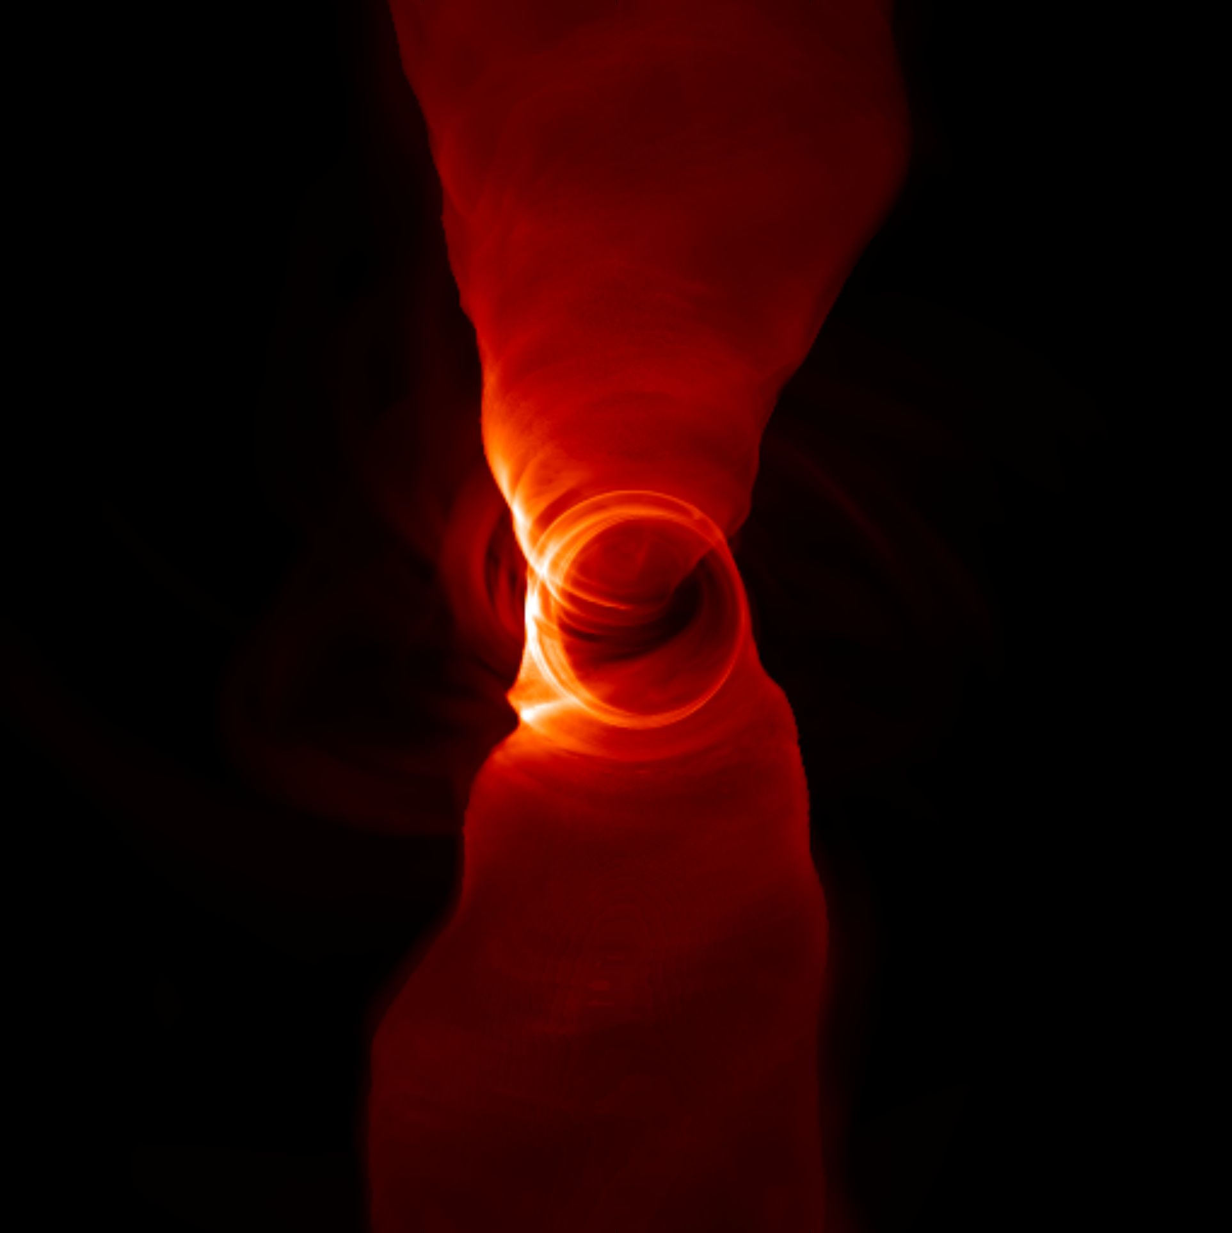
Using General Relativistic Magnetohydrodynamic Simulations To Probe The Parameter Space Of Sgr A*
Devin Cameron, University of Arizona
Dr. Dimitrios Psaltis, BH PIRE
NASA Space Grant Symposium
Arizona State University, April 13, 2019
Source: Lia Medeiros

Slide 2
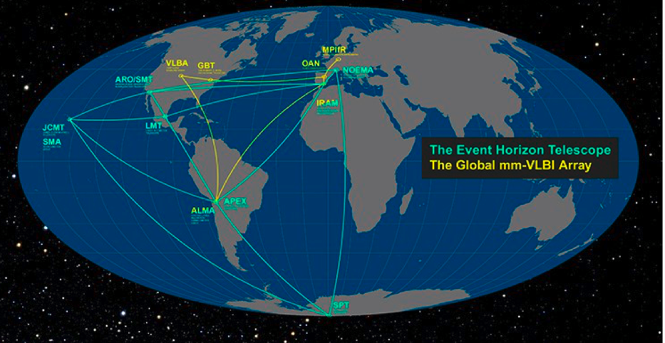
Event Horizon Telescope

Slide 3
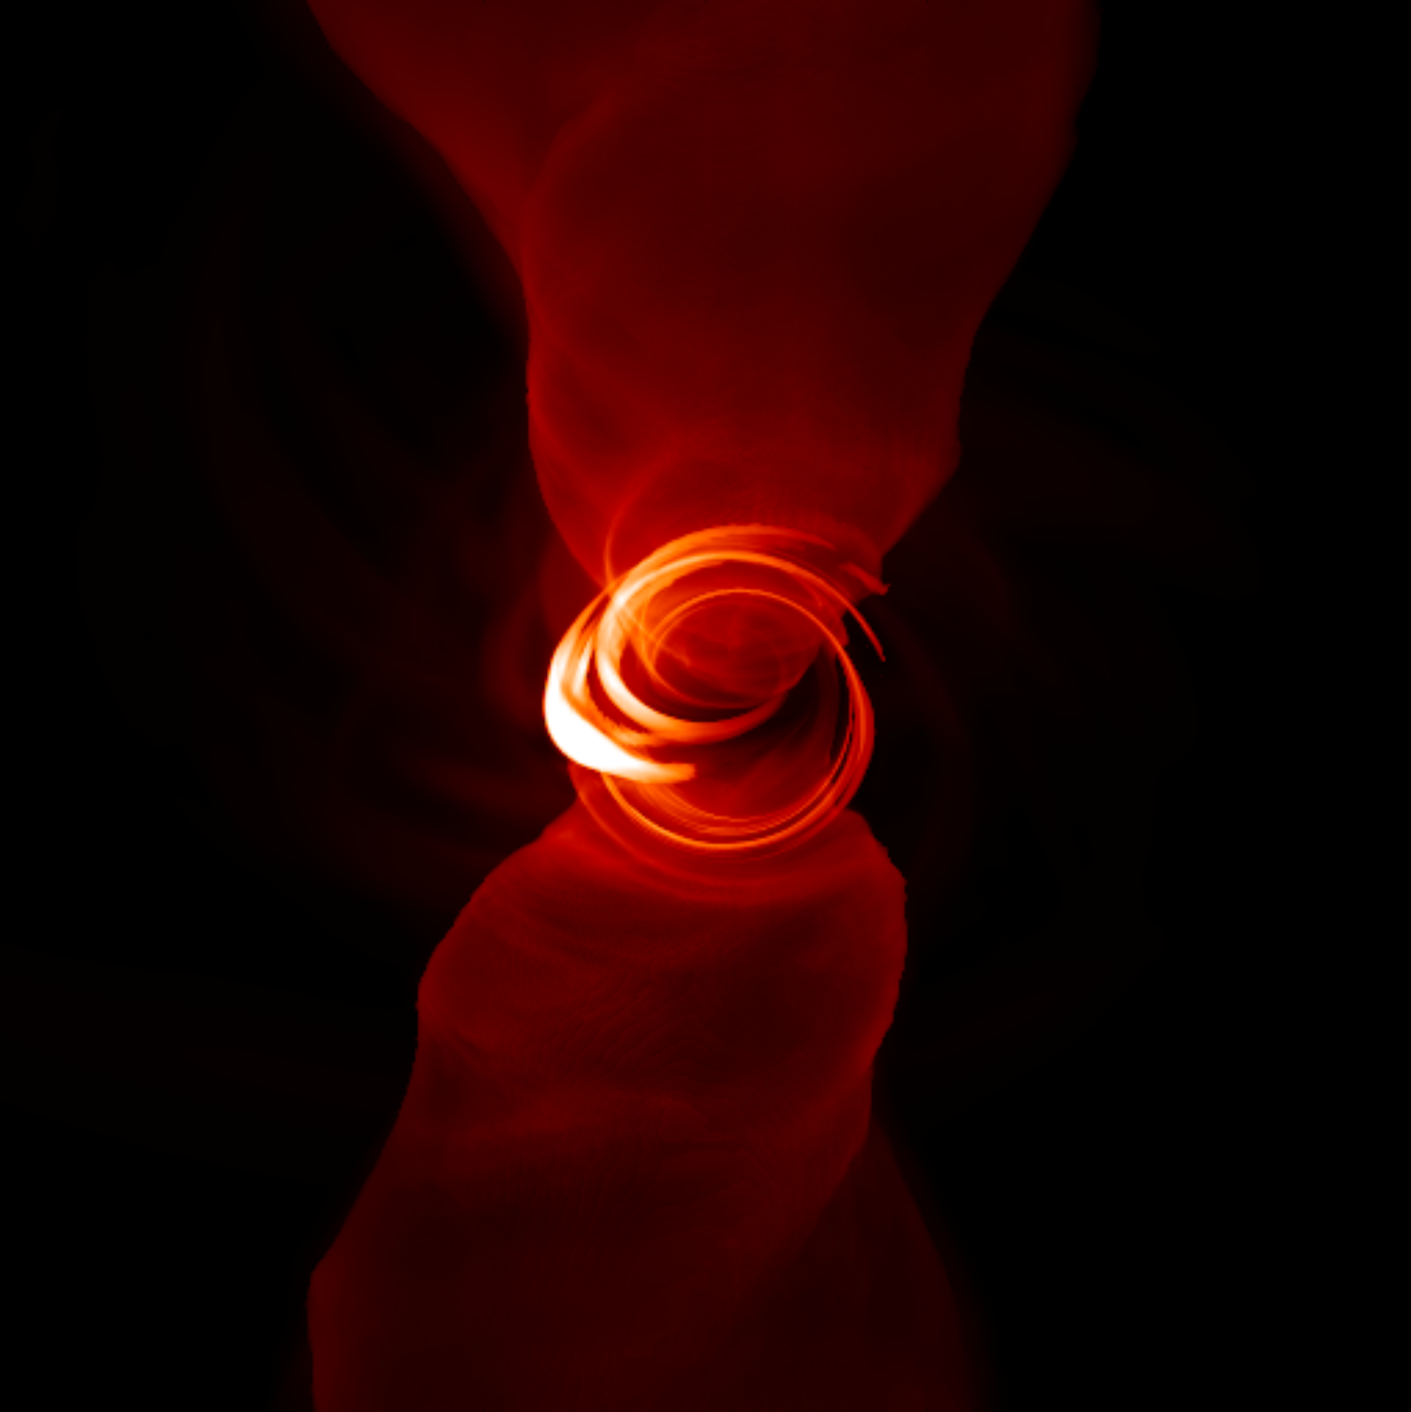
Observe The Silhouette Of A Black Hole
Event Horizon Telescope will observe the hot accretion disk against the black background of the event horizon
Credit: Lia Medeiros
Notes:
What are we taking a picture of?

Slide 4
What Role Do GRMHD Simulations Play?
Accretion flows around black holes are extremely complex and turbulent
Numerical models predict what EHT could see
Comparing initial observations to theoretical images will determine if General Relativity fully describes the spacetime around a black hole
Notes:
What EHT is, what is the goal, how is EHT going to achieve this…. But what is EHT going to observe?

Slide 5
Objective
To supply EHT with a library of GRMHD simulations that account for every combination of parameters along the domain of those parameters

Slide 6
Extremely LarGe Advanced TechnOlogy (El-Gato)
High Performance Computer funded by the National Science Foundation and the University of Arizona
70 nodes: NVIDIA K20 Graphics Processing Units (GPUs)
20 nodes: Intel Xeon Phi Coprocessors
46 nodes: Intel Ivy Bridge Central Processing Units (CPUs)

Slide 7
General Relativistic Magnetohydrodynamic (GRMHD) Simulations
Solutions from Highly-Accurate Relativistic Magnetohydrodynamic (HARM) code
Ray-tracing algorithm GRay
Images
Principal Component Analysis (PCA)

Slide 8
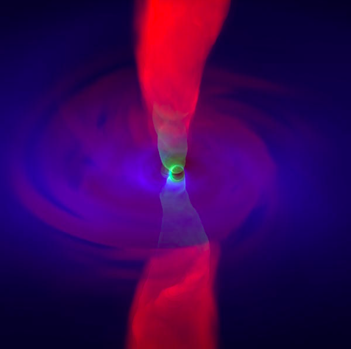
GRay: General Relativistic Ray-Tracing Algorithm
n_{e} - electron number density
t_{disk} - electron-ion temperature ratio
t_{funnel} - different electron-ion temperature ratio
T_{funnel} - constant electron-ion temperature
β - defines the boundary between the disk and funnel/jet
i – inclination angle
Blue ~ X-Ray
Red ~ 1 cm
Green ~ 1 mm
Source: Event Horizon Telescope - Chi-Kwan Chan

Slide 9
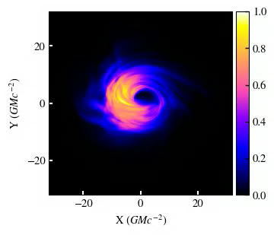
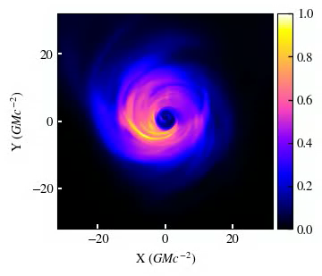
Time evolution simulation of constant parameter t_{disk} and i = 60
Time evolution simulation of constant parameter t_{disk} and i = 5

Slide 10
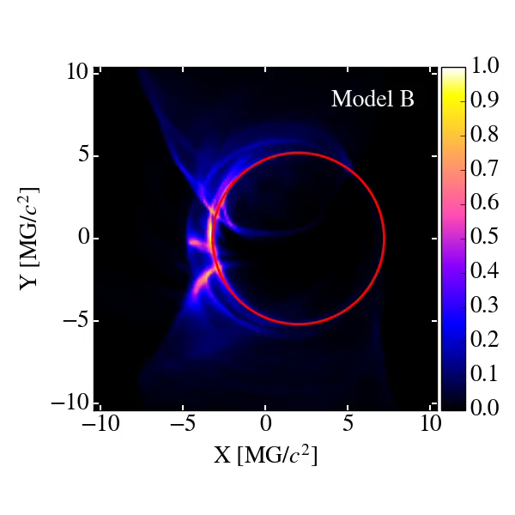
Principal Component Analysis (PCA)

Slide 11
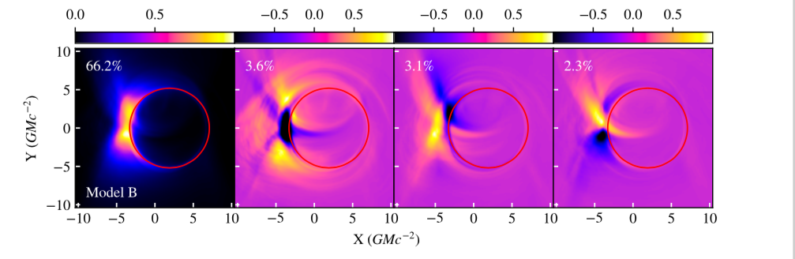
Principal Component Analysis
Credit: Lia Medeiros
Notes:
semi log scale

Slide 12
Results
First observations from EHT have commenced
An exciting initial result has produced ~ 5 papers that have been submitted for publishing
NSF press conference for announcing the first result of EHT will be held:
  April 10, 2019, 9 a.m. EDT

Slide 13
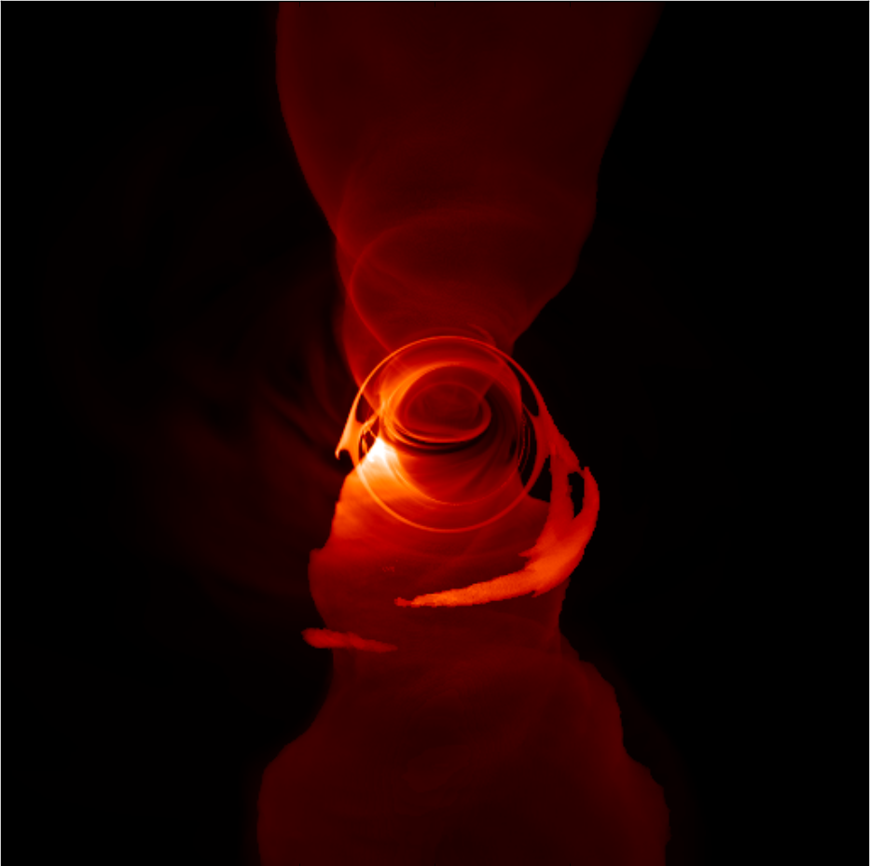
Acknowledgements
Special thanks to:
  NASA Space Grant
  National Science Foundation
  My mentor, Dr. Dimitrios Psaltis
  Dr. Chi-Kwan Chan
  Dr. Lia Medeiros
Source: Lia Medeiros

